Slide 1
Create Engaging Library Reading Lists
SCCITL Conference, July 20th, 2023
Ariana Baker and Allison Faix
Kimbel Library, Coastal Carolina University

Slide 2
What are Reading Lists?
Reading lists are comprised of resources (both required and recommended) that students are expected to utilize in class.
Reading lists link to each source (free web or library record) and provide location and availability (for print resources) and full-text links (for online resources).
Reading lists can be organized by topic, week, etc.

Slide 3
Why This Topic?

Slide 4
Why Use Reading Lists?
Faculty can keep course materials organized and in one place.
Students always know where to find course materials.
Students can easily access library subscription resources through remote authentication.
Resources can be easily integrated into your LMS.
Links, versus downloads, ensure copyright compliance.
Lists can potentially be exported and downloaded by students and faculty.

Slide 5
What we searched for:
Free or low-cost
Work well with LMS (even if they don't integrate)
Easy to use (and easier to use and update than creating a list manually in an LMS, Word document, etc.)
Allows linking to both web and library resources
Has features similar to Leganto (faculty can add notes about readings, organize readings by week or other categories, etc.)

Slide 6
Tool Categories
Annotation and Interactive Discussion Tools
Students can provide an explanation or comment to a text or image.
Citation Manager Tools
Faculty can store, organize, and share references to articles, websites, etc.
Bookmark Sharing Tools
Faculty can save, share, and organize web content.

Slide 7
Annotation / Interactive Discussion Tools
Hypothes.is
Weava
Perusall
NowComment
EMargin

Slide 8
Use Annotation/Interactive Discussion Tools when:
Your main interest is in helping students interact with the texts you are using, either by doing reading notes or annotations, or by discussing readings using the tools available.
You don’t mind each reading list item being separate from the rest (each reading would need to be done separately in some of these tools rather than an overall browsable list).

Slide 9
NowComment

Slide 10
NowComment

Slide 11
eMargin

Slide 12
eMargin

Slide 13
Citation Manager Tools
Paperpile
Zotero
Mendeley
Endnote

Slide 14
Use Citation Manager Tools when:
Your main interest is creating an easy to update reading list to share with students (with the extra benefit of teaching them about citation management by your example).
You want an easy way for students to cite course readings (most citation managers include citation generators in many different citation styles).
You would like students to be able to add to the reading list (many citation managers have a setting where you can choose to allow this or not).

Slide 15
Zotero

Slide 16
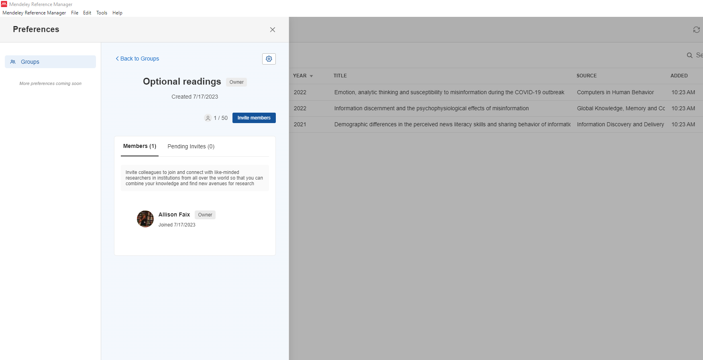
Mendeley

Slide 17
Bookmark Sharing Tools
Raindrop.io (can share lists as public webpages; also includes embed code)

Slide 18
Use Bookmarking Tools when:
You want a simple list of titles and links to resources.
You don't need the additional functionality of a citation manager or a discussion tool.

Slide 19
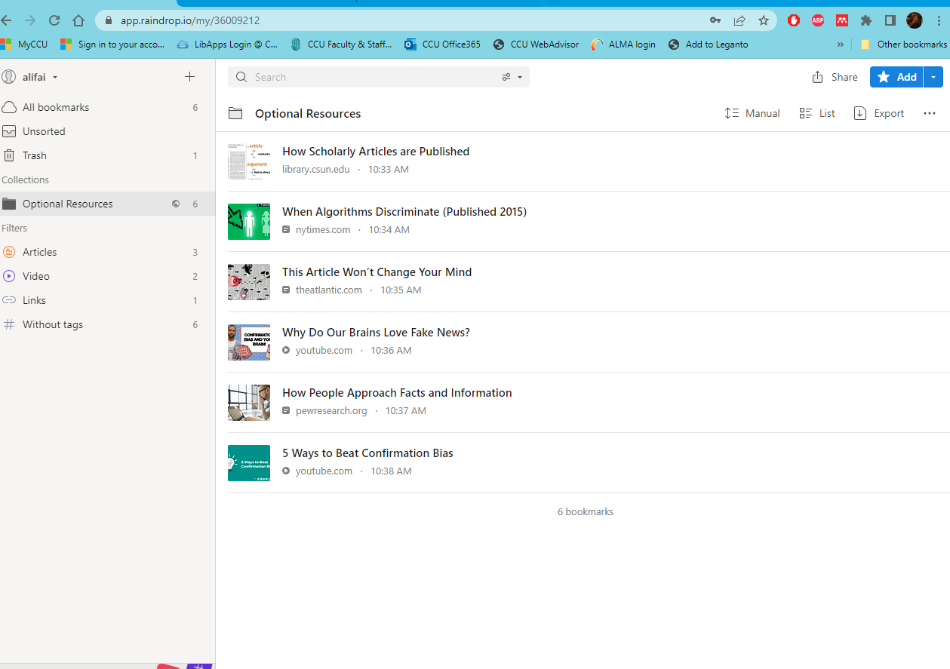
Raindrop.io

Slide 20
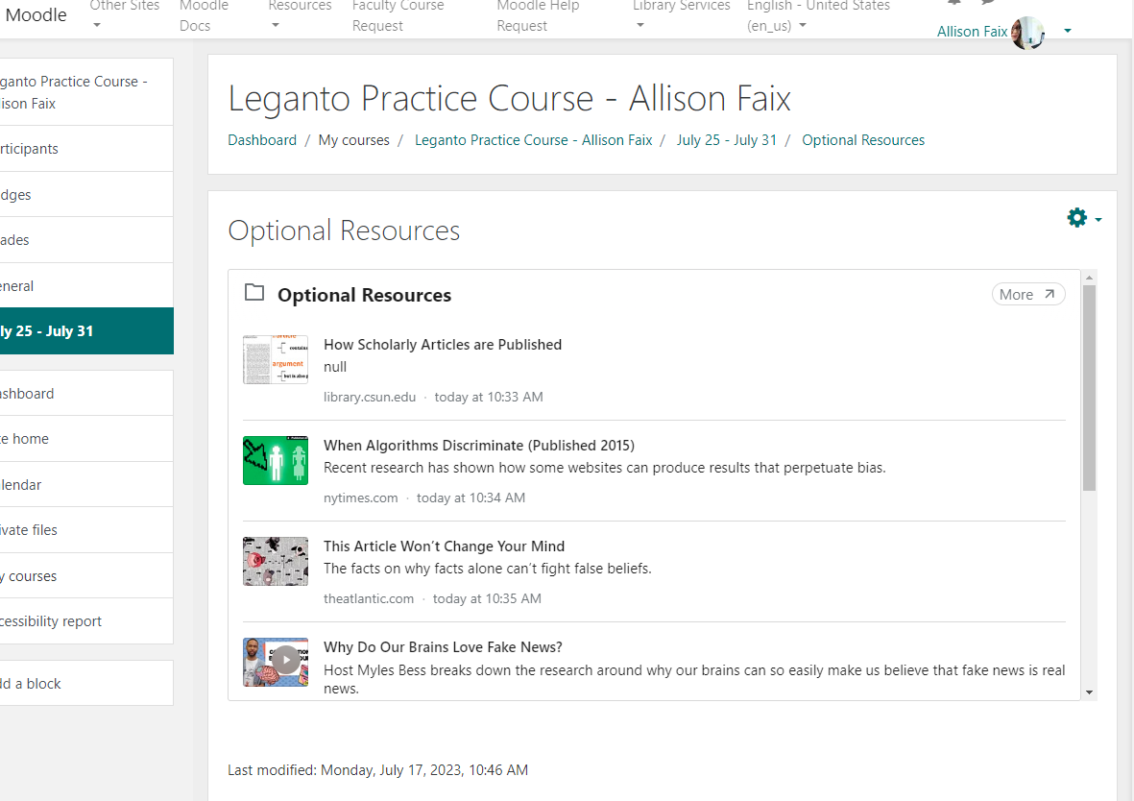
Raindrop.io embedded in Moodle

Slide 21
Combination/Other
Diigo (allows bookmark sharing with groups, plus some commenting on bookmarks and ability to start discussion topics within groups)
Evernote

Slide 22
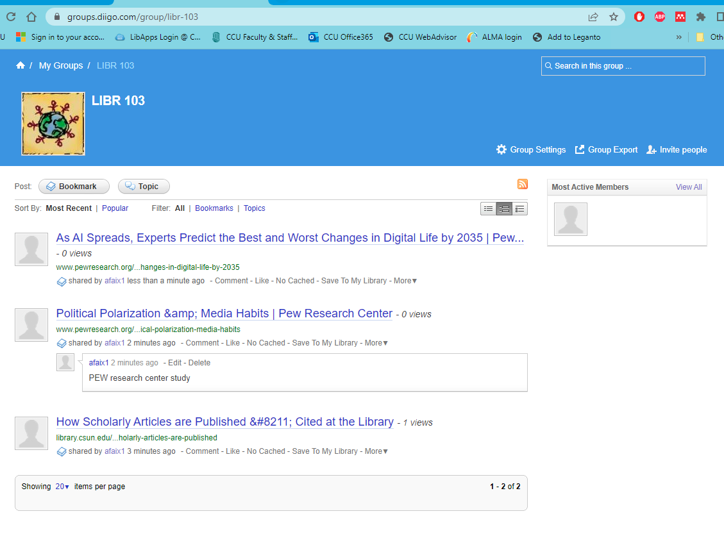
Diigo.com

Slide 23
Evernote

Slide 24
Evernote

Slide 25
Questions?
https://digitalcommons.coastal.edu/sccitl/2023/fullconference/32/

