Slide 1
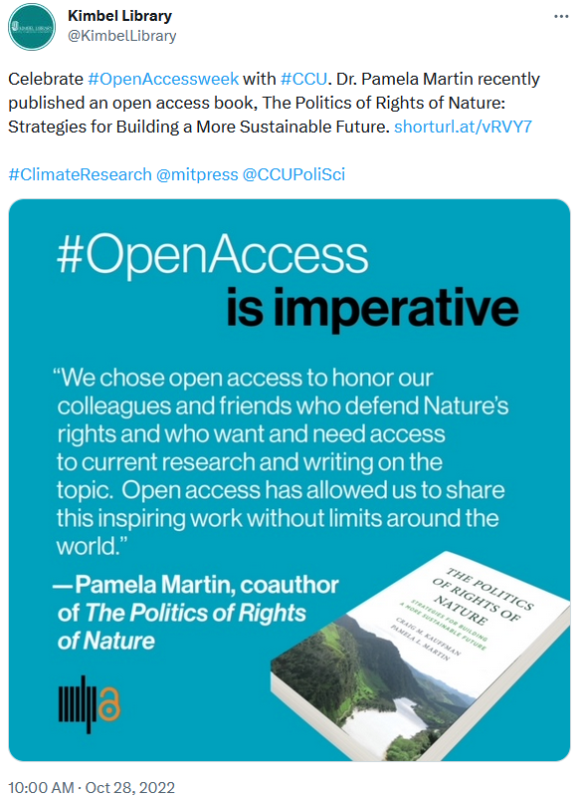
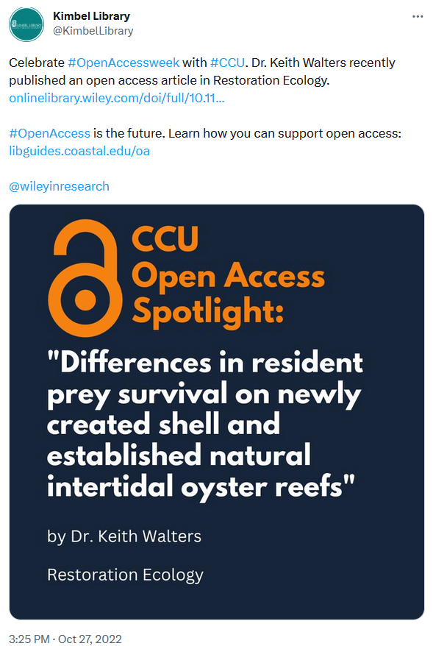
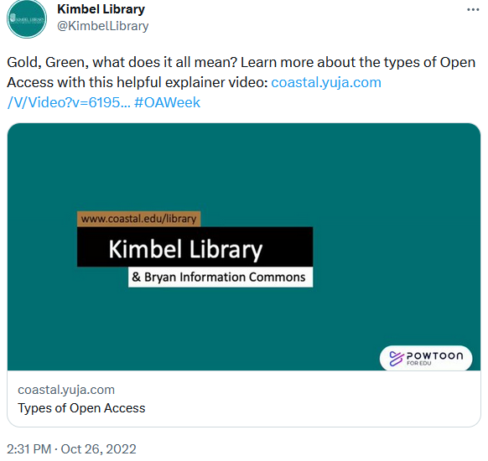
Opening the Door to Open Access
Samantha Duncan, Instructional Design Librarian, Coastal Carolina University
Ariana Baker, Scholarly Engagement Librarian, Coastal Carolina University
What is Open Access (OA)?
“Open Access is the free, immediate, online availability of research articles coupled with the rights to use these articles fully in the digital environment.” - SPARC
Coastal Carolina University Libraries’ Open Access Initiatives:
LibGuide: libguides.coastal.edu/OA
Transformative Agreements
Article Processing Charge (APC) Fund
Open Access Statement
Promotion of Open Access Initiatives
Open Access LibGuide
Open Access workshops
Social media
Open Access videos
What is Open Access?
Types of Open Access
Open Access Facts and Myths
Make Your Publications Open Access
Transformative Agreements
Video Design Process & Goals
Planning & Development: Outreach, instruction, and training
Pre-Production: Topics and template
Production: Record the video
Post-Production: Video edits
Marketing & Distribution: Open Access Week, library video tutorials
Considerations for Openly Licensed Videos
Proprietary software uses copyrighted images
Hosting platforms do not allow video downloads
Video software does not generate an editable file

